Slide 1
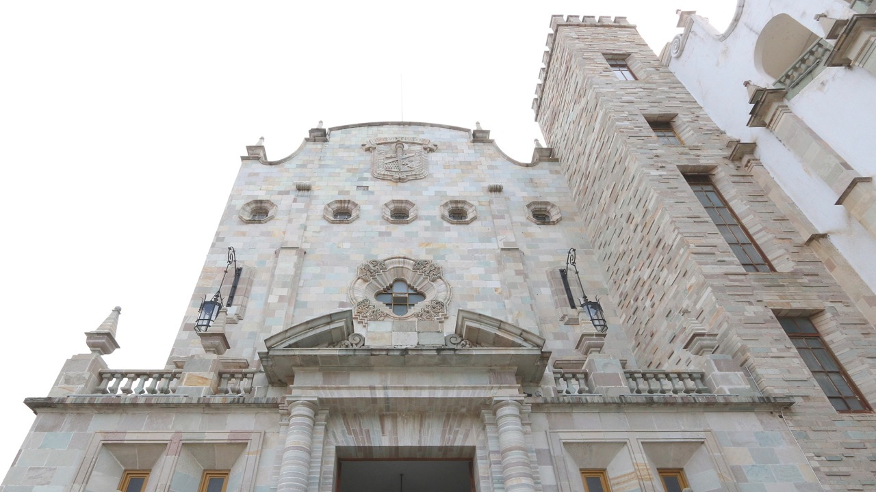
West Virginia University
Education Abroad Fair 2020
November 18, 2020
University of Guanajuato, Mexico.

Slide 2
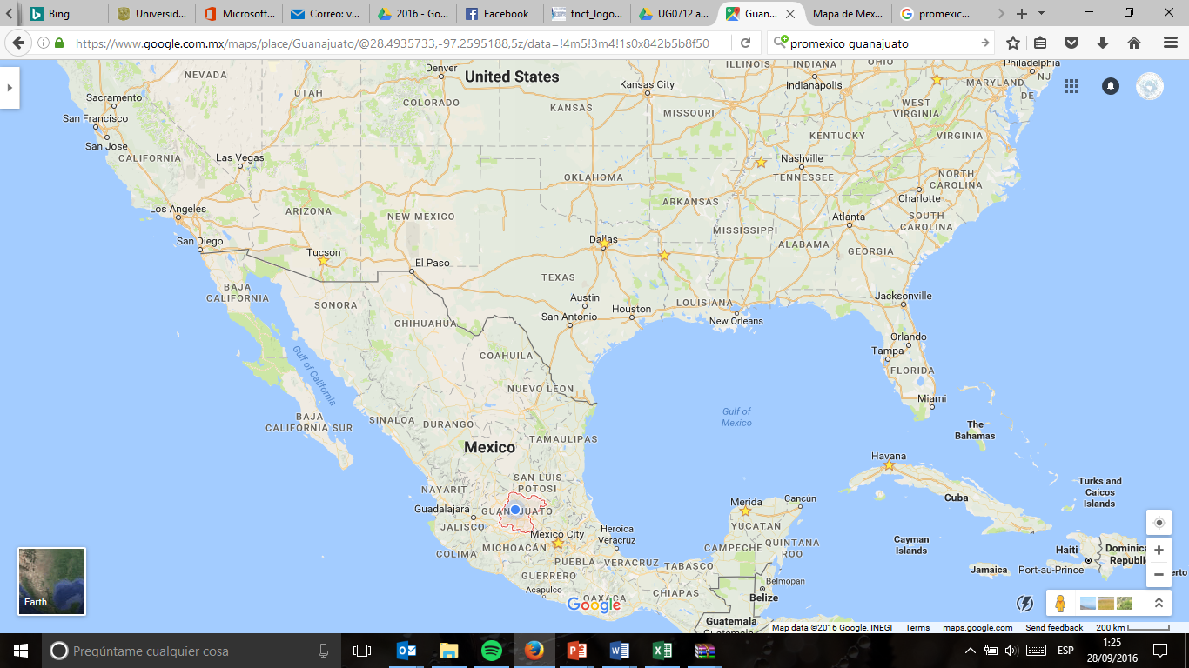
Where are we in Mexico?

Slide 3


UGTO at a glance
Public State University
Students: 40,602
  14,379 High School
  26,223 Undergraduate & graduate
Academic programs: 169
  2 High School Programs
  74 Undergraduate programs
  93 Graduate programs (57 PNPC)
Professors: 2,917
  912 Full time
  500 National System of Researchers (CONACYT)
Research groups: 104
Video Universidad de Guanajuato

Slide 4


Slide 5
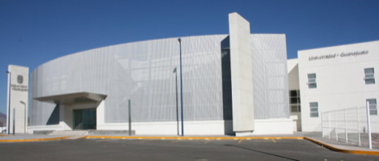
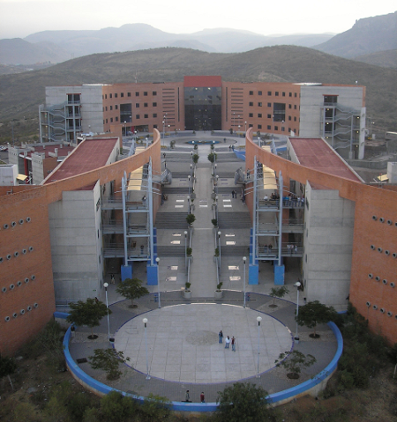
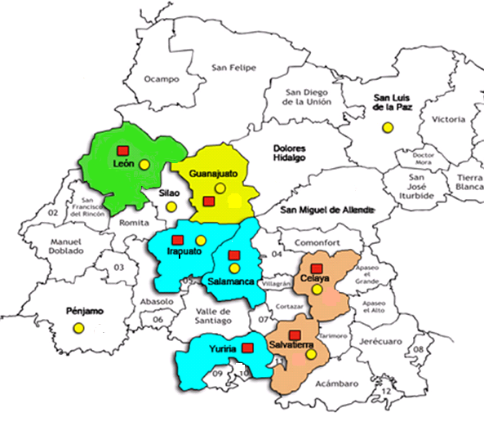
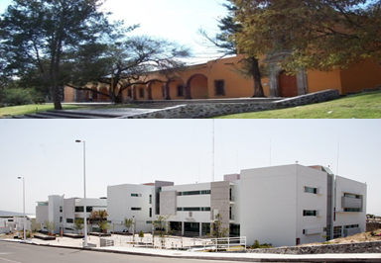
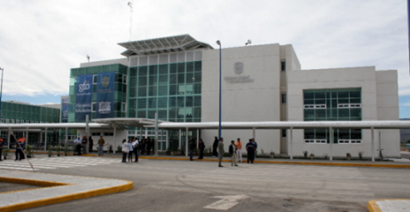
UG Campus, Divisions and High School System
Social Sciences and Humanities
Natural and Exact Sciences
Architecture, Art & Design
Engineering
Economy and Administration
Law, Politics & Government
Campus Guanajuato
Sciences and Engineering
Health Sciences
Social Sciences and
Humanities
Campus León
Campus
Celaya- Salvatierra
Health & Engineering
Social Sciences & Administration
Campus Irapuato-Salamanca
Life Sciences
Engineering
Higher Education
High School
General Program
Technological and International Profile (BTPI)

Slide 6
International Collaboration
Agreements
Students
Double Degrees
395 Academic Collaboration:
285 International
110 National
862 Outgoing/year
742 Incoming/year
7 Double degree programs:
2 Undergraduate
5 Postgraduate
France, Germany, Japan, Spain, USA
247 International students seeking a UG degree
65 International students during Summer Research Program

Slide 7
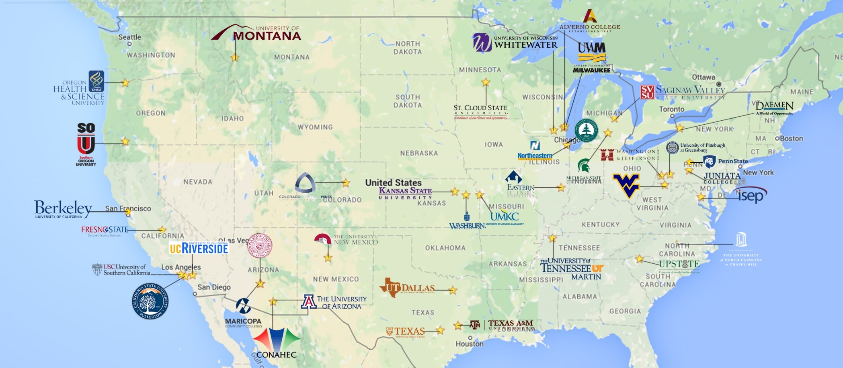
INTERNATIONAL COLLABORATION

Slide 8
International Summer Program
UG Research Strengths
All fields
Tuition fee waived for partner institutions
Partial stipend for room and board
Cultural activities available

Slide 9
UG Research Strengths
331 laboratories in the 4 campuses in the State.

Slide 10
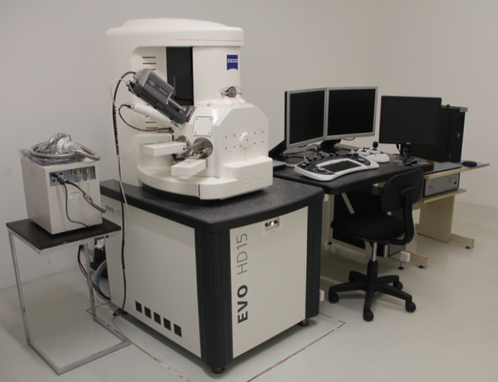
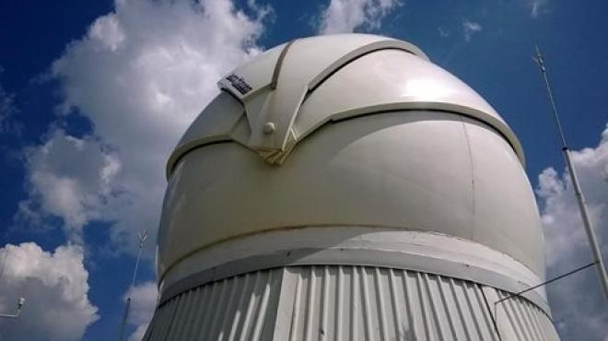
UG Research Strengths
The University of Guanajuato has invested in research facilities that are unique not only in the region, but at national level.
National Laboratory for the Characterization of Physicochemical Properties and Molecular Structure UG-UAA-CONACYT.
TIGRE: International Robotized - Spectroscopic Telescope in Guanajuato.
National Collection of “Agaves” SAGARPA-Universidad de Guanajuato.

Slide 11
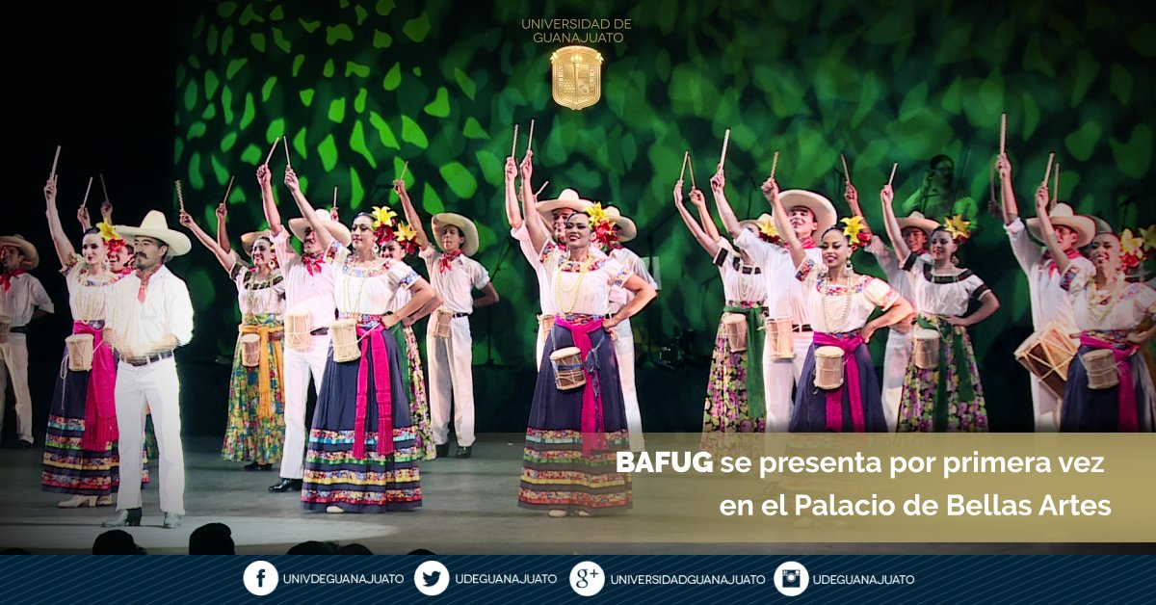

Slide 12


Slide 13


Slide 14
UG Research Strengths
FACULTY SCHOLARS PROFILE
Number of Faculty Scholars specialized and carrying out research as it is shown below:
500 professors are recognized by the National System of Research (SNI), the distinction that endorses the quality of their scientific contributions in Mexico.
21 Demography and Sociology - social movements, indigenous people, religion’s sociology, social theory applications, rural development and public policies, catholicism, secularism, intangible heritage and arts, social problems (poverty, gender studies, gender violence, women, politics), democracy, state and civil society.
22 economic sciences : economic integration of Europe and the Americas, economics of natural resources, agribusiness, economic development models and theories, strategic planning, organizational analysis, financial management, among other related topics.

Slide 15
UG Research Strengths
13 health sciences - neurosciences, environmental toxicology, clinical research on metabolism and reproduction, oxidative stress, occupational health and molecular biomedicine.
36 life sciences - protozoan’s molecular biology, plant biotechnology, immuno-parasitology, insect ecology, among other topics.
15 Human Pathology and medicine - environmental health, nephrology, pediatrics, infectious diseases, endocrinology, epidemiology and molecular biology in metabolic diseases.
14 agronomy & veterinary sciences - rabbit breeding, aquaculture, poultry, molecular biology, phytopathology, horticulture and biotechnology, molecular biology, crop protection, genetics, cattle medicine production, improvement of fruits through genetic resources, among other relevant research topics.

Slide 16
UG Research Strengths
91 technology - sciences : artificial intelligence, food preservation, renewable energies and energy efficiency, phytoremediation, fuel cells, advanced oxidation processes for water pollution control, machine designs, robotics, among others.
60 physics : quantum optics, gravitation, elementary particles, absorption spectroscopy, dynamic arrest of colloids, colloidal glass transition, particle accelerators, bio-photonics, experimental high energy physics, pulsed photo-acoustics, neutrino physics, medical physics and environmental radioactivity, etc-
50 chemistry - polymers recycling, enzymatic synthesis of macromolecules, biochemistry and biotechnology of plants, organometallic compounds, membrane separation processes, computational chemistry, organo-catalysis, nanomaterials, synthesis of heterocyclic compounds, bioinorganic chemistry, etc.

Slide 17
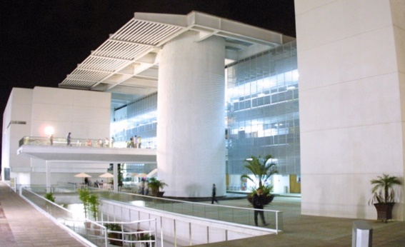
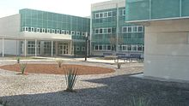
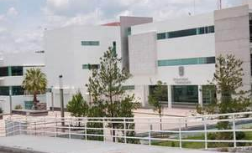
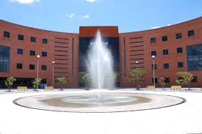
UG Campus, Divisions and High School System
The University of Guanajuato is present in 12 cities in the State of Guanajuato: four campuses and one high school college with ten high schools.
Campuses:
Guanajuato
Irapuato-Salamanca
Celaya-Salvatierra
León
Academic areas:
Natural and Exact Sciences
Engineering
Health Sciences
Economic and Administration Sciences
Social Sciences and Humanities
Arts

Slide 18
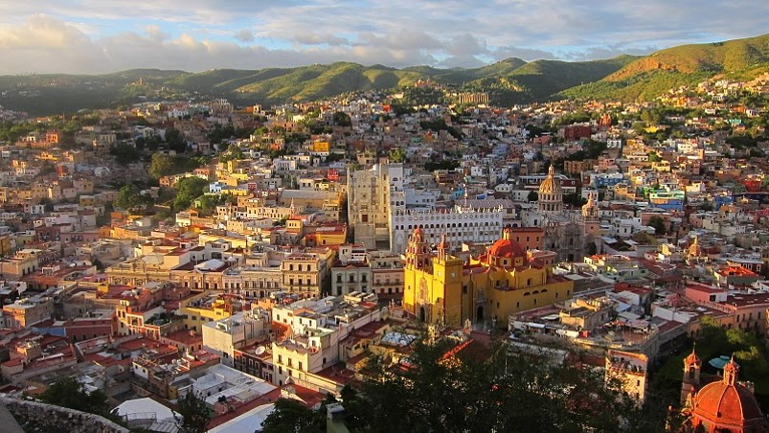
Thank you!

Slide 19



Slide 20
UG RESEARCH STRENGHTS
Faculty Scholars work on specialized and specific research areas and topics that are described below:
Physics: quantum optics, gravitation, elementary particles, absorption spectroscopy, fluids rheology and microrheology, dynamic arrest of colloids, colloidal glass transition, particle accelerators, biophotonics, gravitation and cosmology, soft condensed matter, photoconductive fiber optics, fiber lasers, amended gravitational theories , mathematics and physics, unclassical cosmology, particle physics; experimental high energy physics, pulsed photoacoustics, alternative theories of gravity, string theory, neutrino physics, dark matter, medical physics and environmental radioactivity.

Slide 21
UG RESEARCH STRENGHTS
Chemistry: polymers recycling, medical chemisrty, enzymatic synthesis of macromolecules, renal pharmacology, chromatographic and spectrometric techniques for biochemical analysis, biochemistry and biotechnology of plants, chemistry of ceramics, organometallic compounds, electrochemistry, membrane separation processes, theoretical and computational chemistry, organocatalysis, nanomaterials, synthesis of heteorcyclic compounds, bioinorganic chemistry, speciation analysis.
Mathematics: on stochastic finances, fixed point theorems in Banach Spaces, probability applications, Gr-functors (algebra), holomorphic foliations, invariant theory among other mathematical applications.

Slide 22
UG RESEARCH STRENGHTS
Technology Sciences: artificial intelligence, food preservation, renewable energies and energy efficiency, phytoremediation, fuel cells, advanced oxidation processes for water pollution control, machine designs, robotics.
Earth Sciences: hydro-geology, hydrodynamic & hydro geochemical models for groundwater, structural geology and plate tectonics, paleo-limnology and sedimentology, applied mathematics for coastal processes, and pollution control for water quality.
Astronomy and astrophysics: radioastronomy, stellar formation, protoplanetary discs issuance, formation & evolution of galaxies, supernovas, dark matter, massive stars, gravitation and cosmology.

Slide 23
UG RESEARCH STRENGHTS
Agronomy & Veterinary sciences: rabbit breeding, aquaculture, poultry, molecular biology, phytopathology, horticulture and biotechnology, molecular biology, crop protection, genetics, cattle medicine production, improvement of fruits through genetic resources.
Health Sciences specialities: neurosciences, environmental toxicology, clinical research on metabolism and reproduction, oxidative stress, occupational health and molecular biomedicine.
Life Sciences: protozoan’s molecular biology, plant biotechnology, immunoparasitology, insect ecology.
Human Pathology and Medicine: environmental health, nephrology, pediatrics, infectious diseases, endocrinology, epidemiology and molecular biology in metabolic diseases.

Slide 24
UG RESEARCH STRENGHTS
Pshycology: environmental psychology, behaviour, experimental analysis, gender violence, health psychology, groupal relations, community psychology: indigenous people living in the Mexican southestern, will psychology , cognotive functions, suicide behaviour and brain functions.
Legal Sciences: criminology, tax law, criminal law, constitutional law and gender studies.
Political Sciences faculty members working on democracy, international relations, political culture, electoral behavior, environmental policies.
Economic Sciences specialities: economic integration of Europe and the Americas, economics of natural resources, agribusiness, economic development models and theories, strategic planning, organizational analysis, financial management.

Slide 25
UG RESEARCH STRENGHTS
Phylosophy & Linguistics professors working on phylosophy of social theories , ethics, mexican phylosophy, metaphysics: contemporary ontology, sociolinguistics, otomí texts, language teaching.
History & geography professors developing research on water & agrarian history, regional & urban history, resources management , gepolitics, international migration and transdisciplinary studies on Mesoamerica.
Demography and Sociology professors working on social movements, indigenous people, religion’s sociology, social theory applications, rural development and public policies, catholicism, secularism, intangible heritage and arts, social problems (poverty, gender studies, gender violence, women, politics), democracy, state and civil society.
Anthropology: migration, social responsibility, environmental sustainability.
Arts: music, American (hispanoamerican) & contemporary literature, urbanism.

Slide 26
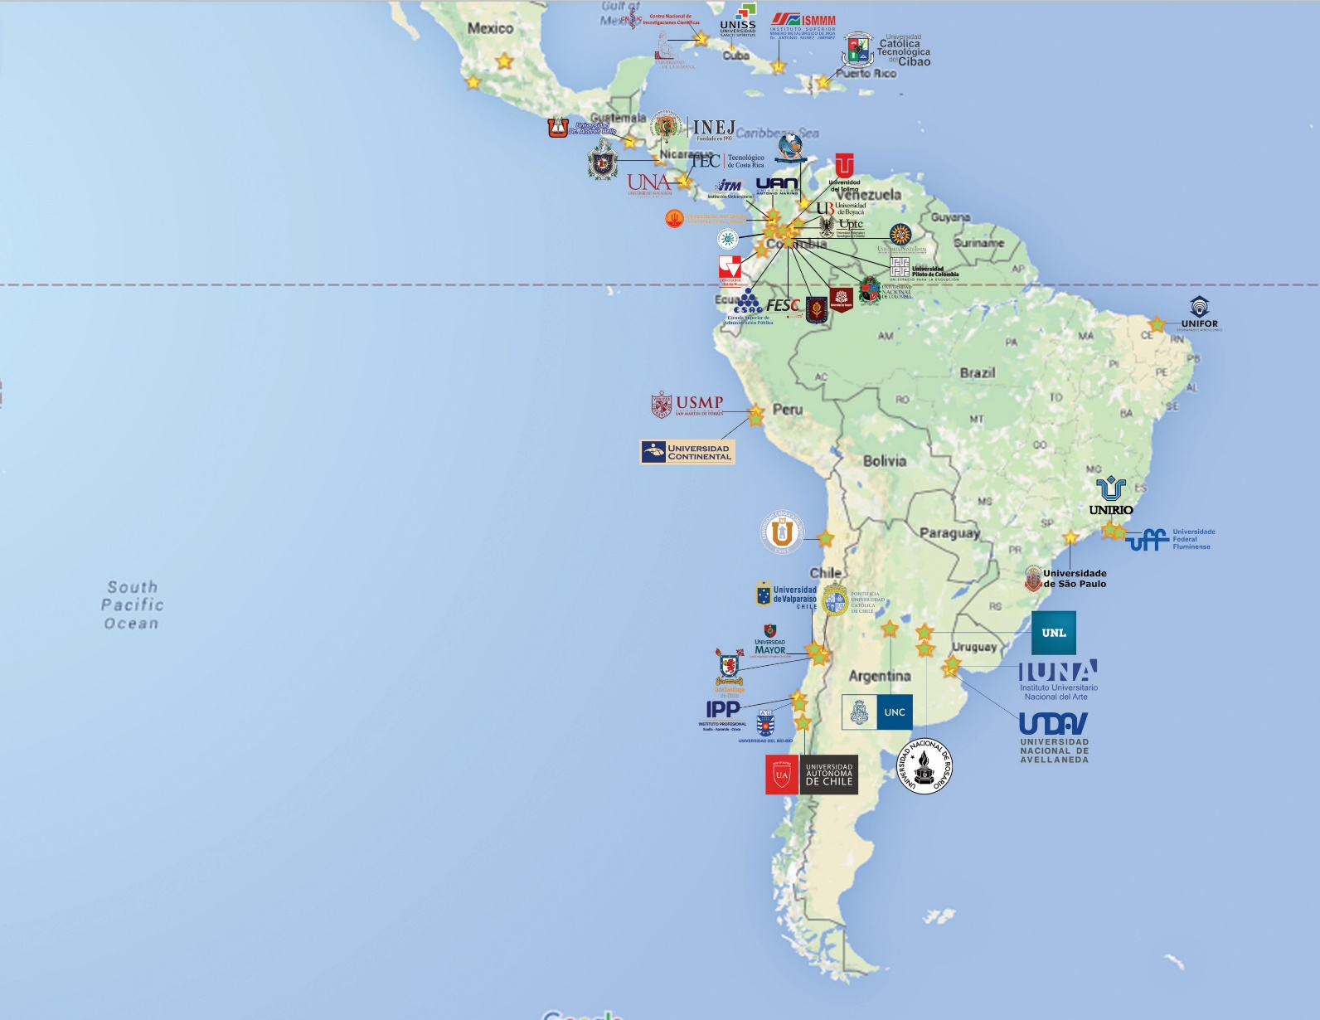
INTERNATIONAL COLLABORATION

Slide 27
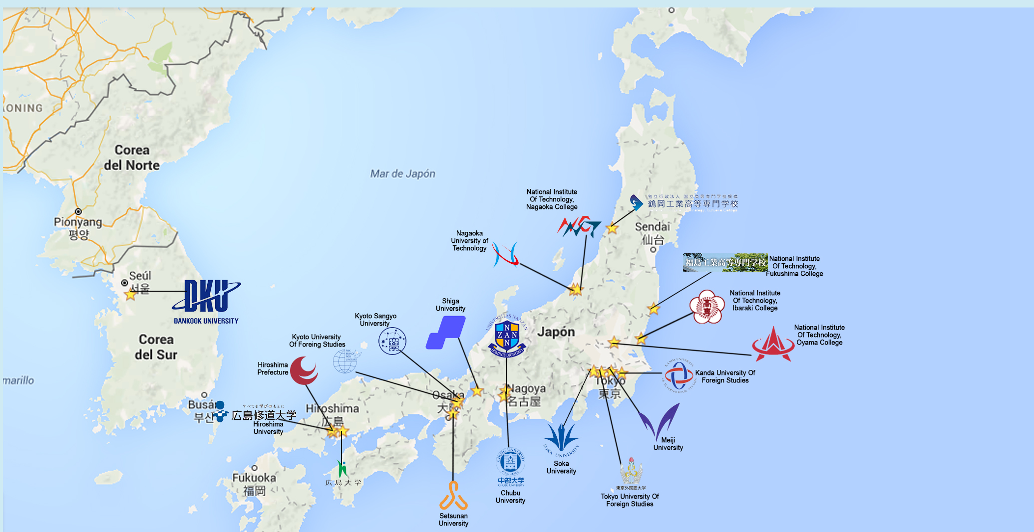
INTERNATIONAL COLLABORATION

Slide 28
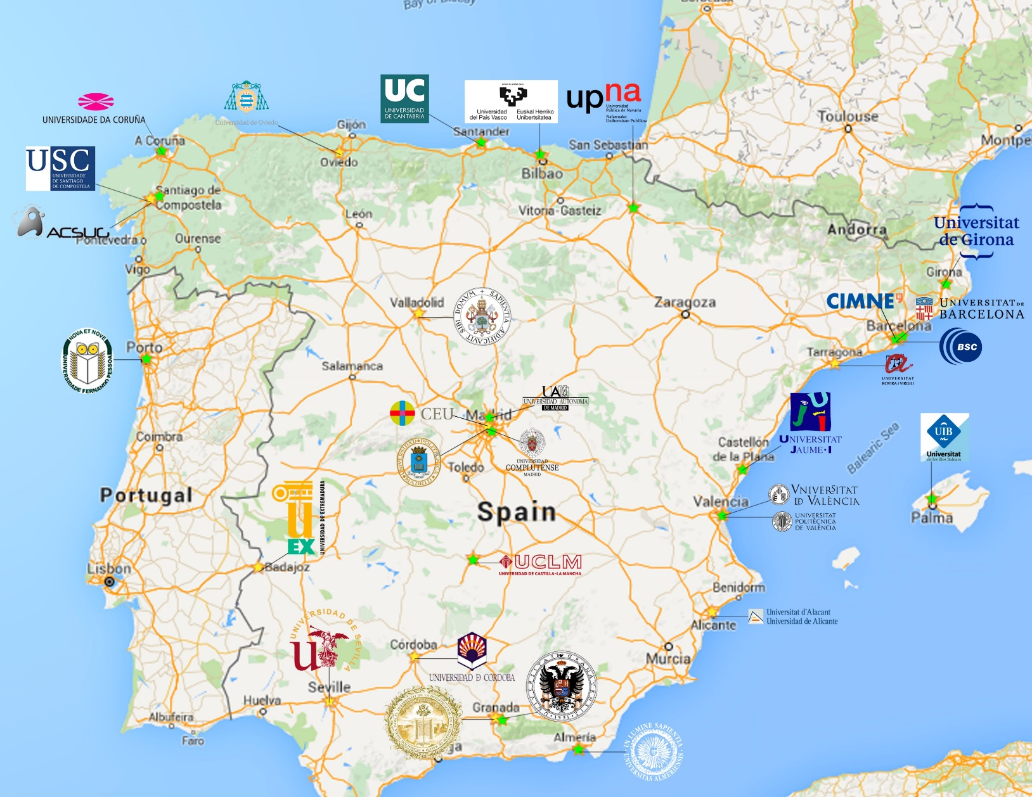
INTERNATIONAL COLLABORATION

Slide 29
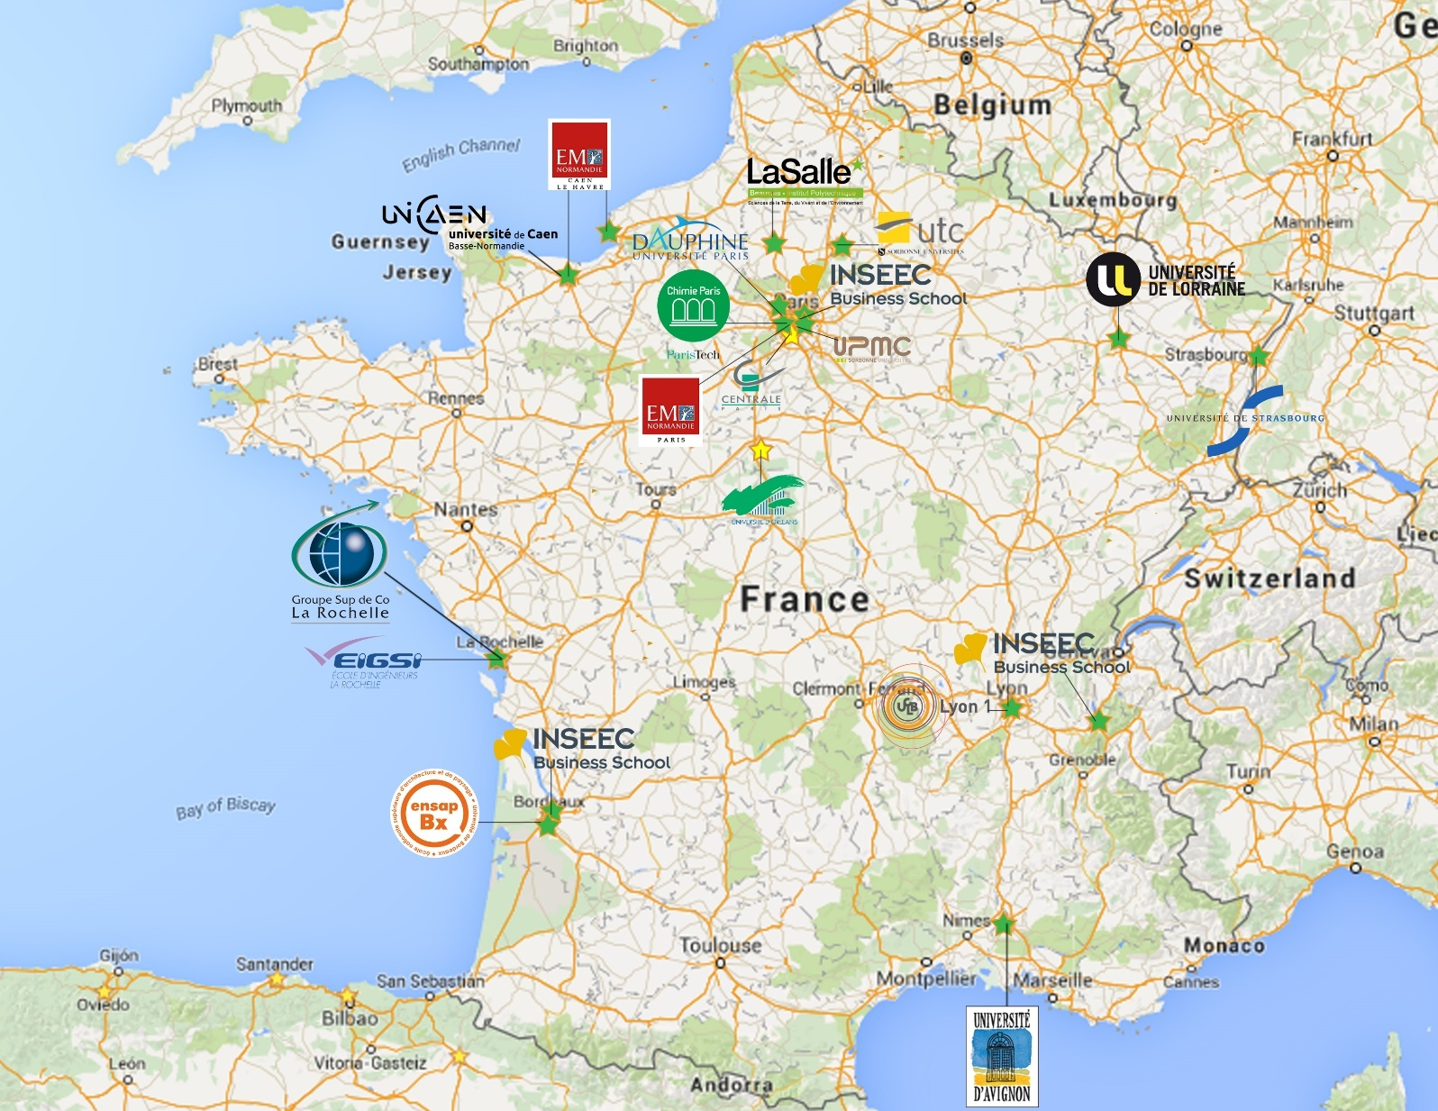
INTERNATIONAL COLLABORATION

